Slide 1
Module – 4
Chapter – 10
Artificial Neural Network

Slide 2
10.1 INTRODUCTION
Artificial Neural Networks (ANN) are inspired by the human brain.
Human brain:
Made of neurons
Learns from experience
Processes information
ANN:
Made of artificial neurons (nodes)
Learns from data
Used in AI applications
Example:
Face recognition in mobile phones
Google voice assistant understanding speech
ANN tries to mimic how humans think and learn

Slide 3
10.1 INTRODUCTION
The human nervous system has billions of neurons that are the processing units which make humans to perceive things, to hear, to see and to smell.
The human nervous system works beautifully, making us understand who we are, what we do, where we are and everything in our surrounding.
It makes us to remember, recognize and correlate things around us.
It is a learning system that consists of functional units called nerve cells, typically called as neurons.
The human nervous system is divided into two sections called the Central Nervous System (CNS) and the Peripheral Nervous System (PNS).

Slide 4
10.1 INTRODUCTION
Human body has billions of neurons.
Functions:
  Seeing, hearing, smelling
  Thinking and remembering
Types of neurons:
Sensory neurons → carry input to brain
Motor neurons → send commands to body
Interneurons → connect neurons
System parts:
CNS (Central Nervous System) → brain & spinal cord
PNS (Peripheral Nervous System) → rest of neurons
Neurons receive → process → send information

Slide 5
The brain and the spinal cord constitute the CNS and the neurons inside and outside the CNS constitute the PNS.
The neurons are basically classified into three types called sensory neurons, motor neurons and interneurons.
Sensory neurons get information from different parts of the body and bring it into the CNS, whereas motor neurons receive information from other neurons and transmit commands to the body parts.
The CNS consists of only interneurons which connect one neuron to another neuron by receiving information from one neuron and transmitting it to another.
The basic functionality of a neuron is to receive information, process it and then transmit it to another neuron or to a body part.

Slide 6
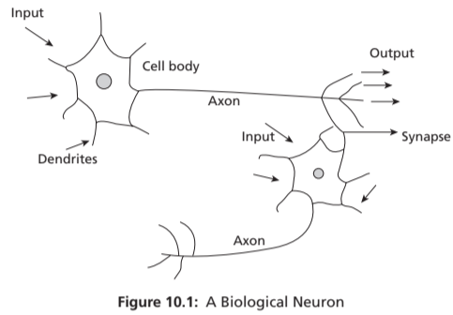
10.2 BIOLOGICAL NEURONS
A neuron has:
Dendrites → receive input
Soma (cell body) → process input
Axon → send output
Synapse → connection to next neuron
Example:
When you touch a hot object:
Sensors send signal → brain processes → hand moves away

Slide 7
10.2 WORKING OF BIOLOGICAL NEURONS
Neuron fires only when input crosses threshold.
One neuron can connect to thousands of neurons.
Signals are passed using electrical impulses (spikes).
Neurons form a network → same idea used in ANN

Slide 8
10.2 BIOLOGICAL NEURONS
A typical biological neuron has four parts called dendrites, soma, axon and synapse. The body of the neuron is called as soma.
Dendrites accept the input information and process it in the cell body called soma.
A single neuron is connected by axons to around 10,000 neurons and through these axons the processed information is passed from one neuron to another neuron.
A neuron gets fired if the input information crosses a threshold value and transmits signals to another neuron through a synapse. A synapse gets fired with an electrical impulse called spikes which are transmitted to another neuron.

Slide 9
A single neuron can receive synaptic inputs from one neuron or multiple neurons. These neurons form a network structure which processes input information and gives out a response.

Slide 10
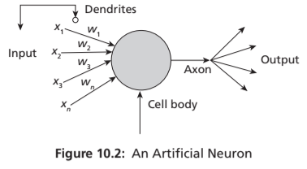
10.3 ARTIFICIAL NEURONS
Artificial neurons are like biological neurons which are called as nodes. A node or a neuron can receive one or more input information and process it. Artificial neurons or nodes are connected by connection links to one another. Each connection link is associated with a synaptic weight. The structure of a single neuron is shown in Figure 10.2.

Slide 11
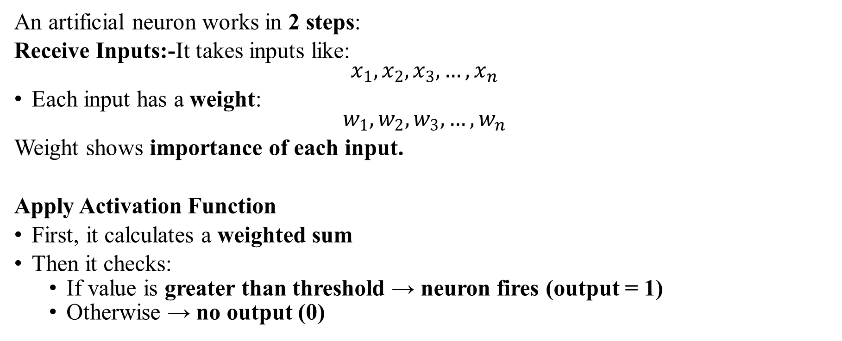
10.3 SIMPLE MODEL OF AN ARTIFICIAL NEURONS
An artificial neuron works in 2 steps:
Receive Inputs:-It takes inputs like:
$$x_{1},x_{2},x_{3},…,x_{n}$$
Each input has a weight:
$w_{1},w_{2},w_{3},…,w_{n}$
Weight shows importance of each input.
Apply Activation Function
First, it calculates a weighted sum
Then it checks:
  If value is greater than threshold → neuron fires (output = 1)
  Otherwise → no output (0)

Slide 12

10.3 SIMPLE MODEL OF AN ARTIFICIAL NEURONS
This means:
Multiply each input with its weight
Add all values together
Real-Life Example
Inputs: Study hours, Sleep hours
Weights: Importance of each
Output: Pass or Fail
In Short,
Input comes in
Multiply with importance (weights)
Add condition (threshold)
Decide output everything
Check

Slide 13
Artificial Neuron
Artificial neuron works similarly:
Inputs (x1, x2, x3…)
Weights (w1, w2, w3…)
Bias
Output
Formula (concept):
Output = Activation (Weighted Sum + Bias)
Example:
Suppose:
Study hours = 5
Sleep hours = 7
Model predicts: Pass or Fail

Slide 14
An artificial neuron takes weighted inputs, computes their sum, and passes it through an activation function to produce output.

Slide 15
Activation Function
It decides: Whether neuron should “fire” or not
Types:
Linear
Non-linear (Sigmoid, ReLU, etc.)
Example:
Output between 0 and 1
  0 → No
  1 → Yes
Like:
Email → Spam (1) or Not Spam (0)

Slide 16
Activation Function
Converts input into output
Adds non-linearity (important for complex problems)
Key points:
Output range:
  (0 to 1) or (-1 to 1)
Linear → simple problems
Non-linear → complex data (images, audio)
Conclusion: Without activation, ANN cannot solve real-world problems.

Slide 17
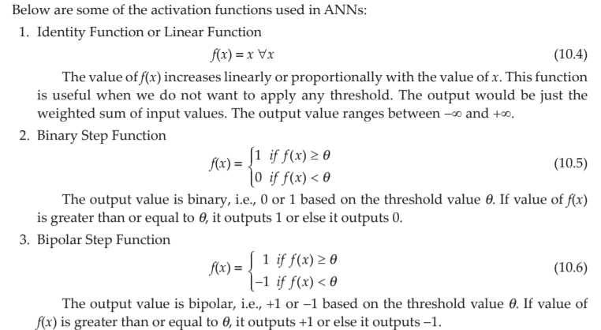

Slide 18
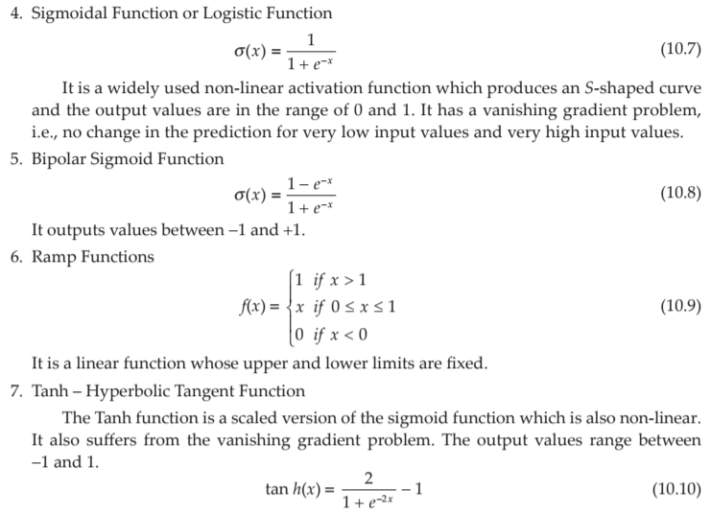

Slide 19
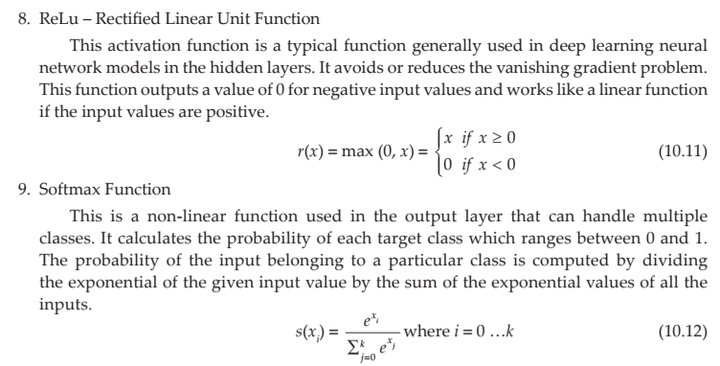

Slide 20
SUMMARY
Function | Output Range | Use
Linear | (-∞, +∞) | Simple models
Step | 0 or 1 | Basic classification
Sigmoid | (0,1) | Probability
Tanh | (-1,1) | Better learning
ReLU | [0, ∞) | Deep learning
Leaky ReLU | (-∞, ∞) | Improved ReLU

Slide 21
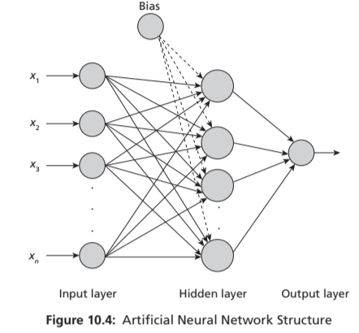
10.3.3 ARTIFICIAL NEURAL NETWORK STRUCTURE
ANN structure means how neurons are arranged and connected in a network.
It defines:
Number of layers
Number of neurons
How they are connected

Slide 22
10.3.3 ARTIFICIAL NEURAL NETWORK STRUCTURE
An ANN is mainly divided into 3 layers:
Input Layer
Hidden Layer
Output Layer

Slide 23
10.3.3 ARTIFICIAL NEURAL NETWORK STRUCTURE
Input Layer
Takes input data
Example: image pixels, marks, hours studied
No processing happens here
Hidden Layer
Performs actual processing/calculation
Can be one or many layers
Uses weights, bias, and activation functions
More hidden layers = more powerful model
Output Layer
Gives final result
Example:
  Pass / Fail
  Spam / Not Spam
  Disease prediction

Slide 24
10.3.3 TYPES OF ANN STRUCTURE
Single Layer Network
Only input + output layer
No hidden layer
Example: Perceptron
Used for simple problems
Multi-Layer Network (MLP)
Has one or more hidden layers
Fully connected network
Used for:
Image recognition
Speech processing
Complex problems

Slide 25
10.3.3 TYPES OF ANN STRUCTURE
Feedforward Network
Data flows only one direction
Input → Hidden → Output
No feedback or loops
Recurrent Network (RNN)
Has feedback connections
Output can go back as input
Used in:
Text processing
Speech recognition

Slide 26
KEY POINT OF TYPES OF ANN STRUCTURE
ANN structure = arrangement of neurons in layers
3 main layers: Input, Hidden, Output
Two common types:
Single layer
Multi-layer

Slide 27
10.4 PERCEPTRON AND LEARNING THEORY
The first neural network model ‘Perceptron’, designed by Frank Rosenblatt in 1958, is a linear binary classifier used for supervised learning.
He modified the McCulloch & Pitts Neuron model by combining two concepts, McCulloch-Pitts model of an artificial neuron and Hebbian learning rule of adjusting weights.
He introduced variable weight values and an extra input that represents bias to this model.
He proposed that artificial neurons could actually learn weights and thresholds from data and came up with a supervised learning algorithm that enabled the artificial neurons to learn the correct weights from training data by itself.

Slide 28
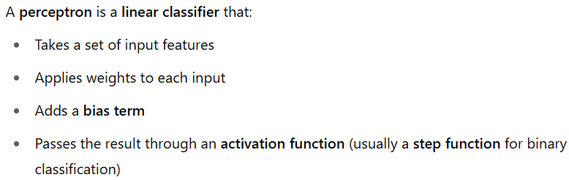
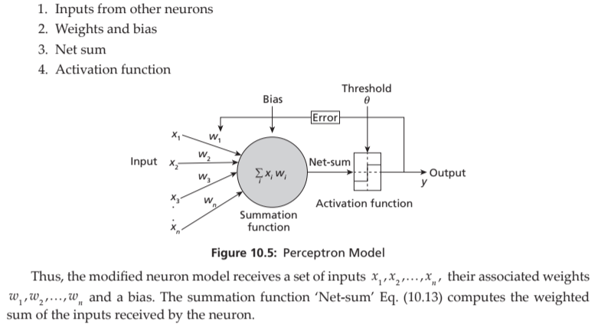
The perceptron model (shown in Figure 10.5) consists of 4 steps:

Slide 29
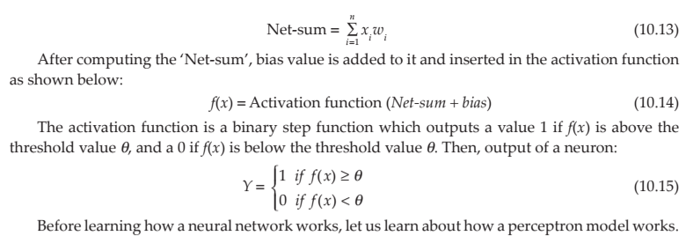

Slide 30
In neural networks, "bias" refers to a constant value added to the output of a neuron before it's passed through the activation function.
It acts as a threshold or offset, allowing neurons to activate even when the weighted sum of inputs is not sufficient
Simple Meaning:
Bias → extra value added to adjust output
Learning Rate → how fast model learns
Functions:
Step function → gives 0 or 1
Activation function → introduces non-linearity
Simple idea: Helps model make decisions.
Learning rate is a hyperparameter that governs how much a machine learning model adjusts its parameters at each step of its optimization algorithm

Slide 31
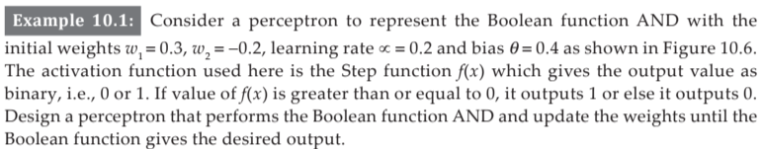
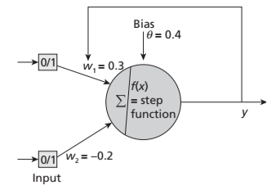
Activation func :A mathematical function applied to a neuron's output to introduce non-linearity into the model.
Step func: A binary activation function that outputs either 0 or 1 based on whether the input is above or below a threshold.

Slide 32
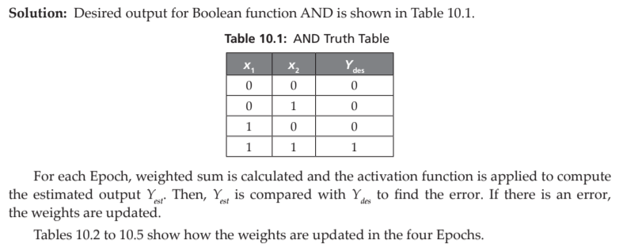

Slide 33
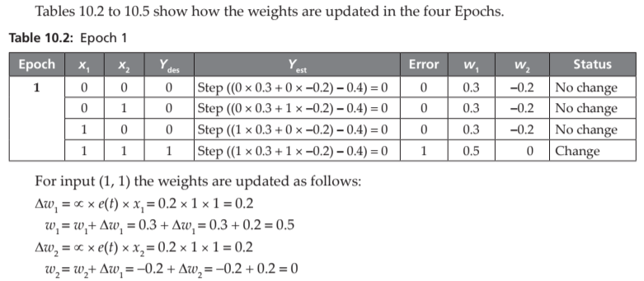

The table implements that threshold by subtracting 0.4 in the net input

Slide 35
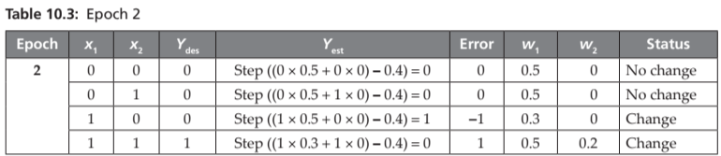
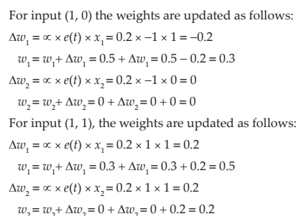

Slide 36
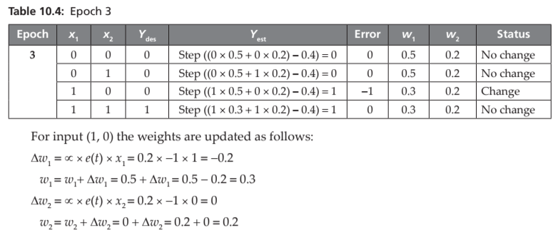

Slide 37
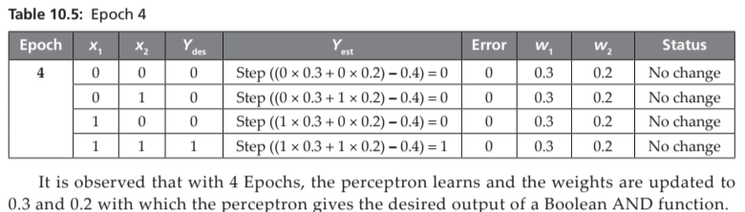

Slide 38
Why Epoch is Considered?
One pass is not enough to learn
We repeat multiple epochs to:
  Reduce errors
  Adjust weights
  Achieve correct output
Training stops when:
All outputs are correct OR
Error becomes minimum

Slide 39
Learning from Numerical
Perceptron learns step-by-step
Errors → update weights
Epochs → repeat learning cycle
Finally, → correct AND function

Slide 40
An epoch is one complete iteration over the entire training dataset. Multiple epochs are required to adjust weights and minimize error for correct classification.

Slide 41
For Understanding : Linearly separable and Non-Linearly separable
Linearly Separable Data:- Data can be separated sing a straight line (in 2D) or a plane (in higher dimensions).

Slide 42
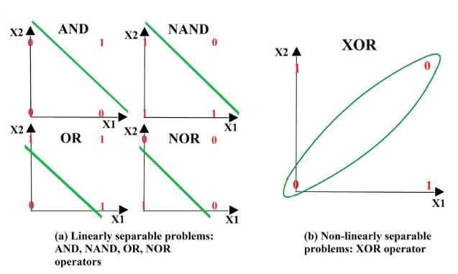
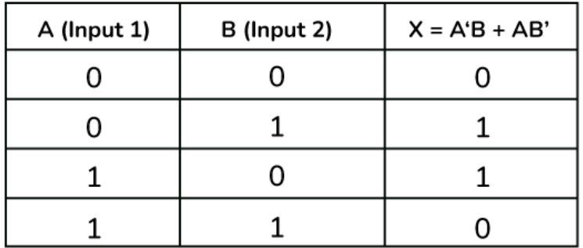
For Understanding : Linearly separable and Non-Linearly separable
Linearly Separable Data:- Data can be separated using a straight line (in 2D) or a plane (in higher dimensions).
XOR

Slide 43
10.4.1 XOR Problem
A perceptron model can solve all Boolean functions which are linearly separable. However, the XOR problem was identified in 1969 by Minsky and Papert.
An XOR function returns a 1, if the two inputs are not equal and a 0 if they are equal. Following is the truth table of an XOR function shown in Table 10.6.

Slide 44
Since XOR is not linearly separable, the single layer perceptron failed to classify and hence this problem led to the evolution of a multi-layer perceptron.
Initially, the Multi-Layer Perceptron (MLP) was not a success due to the lack of an appropriate learning algorithm.
In 1974, Werbos introduced a back propagation algorithm for the three-layered perceptron network and in 1986, a general back propagation algorithm for a multi-layered perceptron was introduced by Rummelhart and Mclelland.
Then, again ANN and Deep Neural Networks became a success, solving many complex problems in the current era.

Slide 45
10.5 GRADIENT DESCENT
Gradient Descent means:-“Step-by-step going down to reach the lowest point (minimum)”.
Explanation using the Example
Situation:
You are standing on top of a mountain
Your goal is to reach the lowest point (valley/lake)
You are blindfolded (you cannot see the whole path)

Slide 46
10.5 GRADIENT DESCENT
What should you do?
Feel the ground around you
Find the direction where it slopes downward
Take a small step down
Repeat the process again and again

Slide 47
10.5 Connection to Machine Learning
Real Life | Machine Learning
Mountain | Error surface (cost function)
Height | Error value
Going down | Reducing error
Steps | Iterations
Lowest point | Minimum error

Slide 48
10.5 Working of Gradient Descent
At each step:
Calculate slope (gradient)
Move in opposite direction of slope
Reduce error gradually

Slide 49
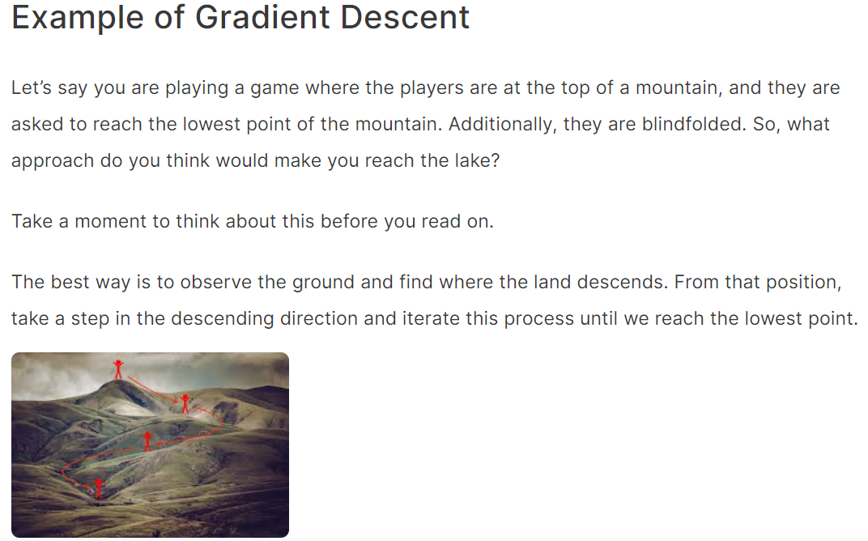
Gradient descent is an iterative optimization algorithm for finding the local minimum of a function.

Slide 50
10.4.2 Delta Learning Rule and Gradient Descent
Generally, Learning in neural networks is performed by adjusting the network weights in order to minimize the difference between the desired and estimated outputs.
This delta difference is measured as an error function or also called as cost function. The cost function, being linear and continuous, is differentiable.
This way of learning called as delta rule (also known as Widrow-Hoff” rule or Adaline rule) is a type of back propagation applied for training the network.
Gradient Descent is an optimization algorithm used to minimize a loss (or cost) function in machine learning and deep learning models.

Slide 51
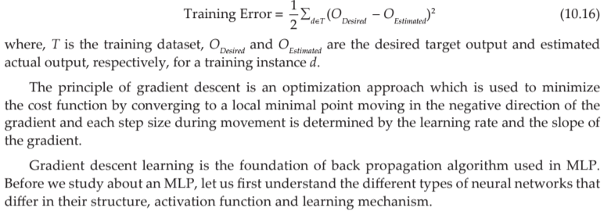
The training error of a hypothesis is half the squared difference between the desired target output and actual output and is given as follows:

Slide 52
10.5 TYPES OF ARTIFICIAL NEURAL NETWORKS
ANNs consist of multiple neurons arranged in layers.
There are different types of ANNs that differ by the network structure, activation function involved and the learning rules used.
In an ANN, there are three layers called input layer, hidden layer and output layer.
Any general ANN would consist of one input layer, one output layer and zero or more hidden layers.

Slide 53
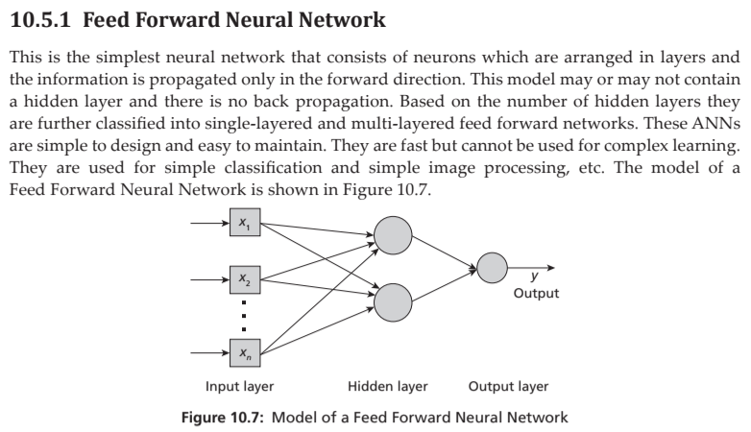

Slide 54
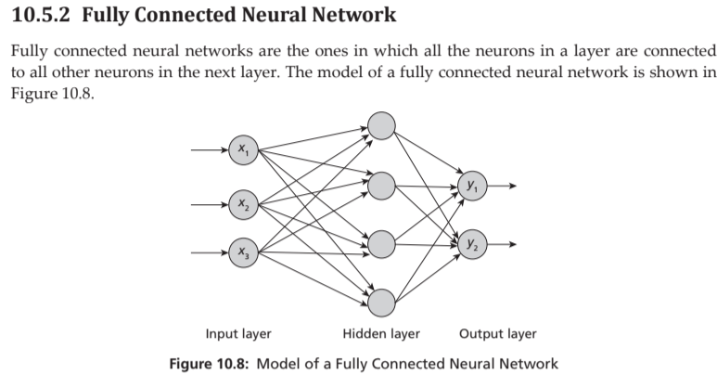

Slide 55
10.5.3 Multi-Layer Perceptron (MLP)
This ANN consists of multiple layers with one input layer, one output layer and one or more hidden layers. Every neuron in a layer is connected to all neurons in the next layer and thus they are fully connected.
The information flows in both the directions. In the forward direction, the inputs are multiplied by weights of neurons and forwarded to the activation function of the neuron and output is passed to the next layer.
If the output is incorrect, then in the backward direction, error is back propagated to adjust the weights and biases to get correct output. Thus, the network learns with the training data.

Slide 56
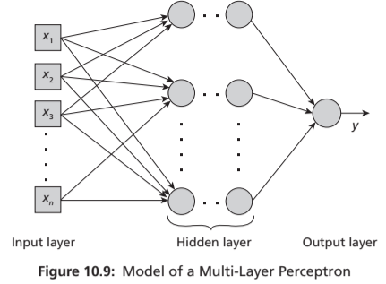
This type of ANN is used in deep learning for complex classification, speech recognition, medical diagnosis, forecasting, etc. They are comparatively complex and slow. The model of an MLP is shown in Figure.

Slide 57
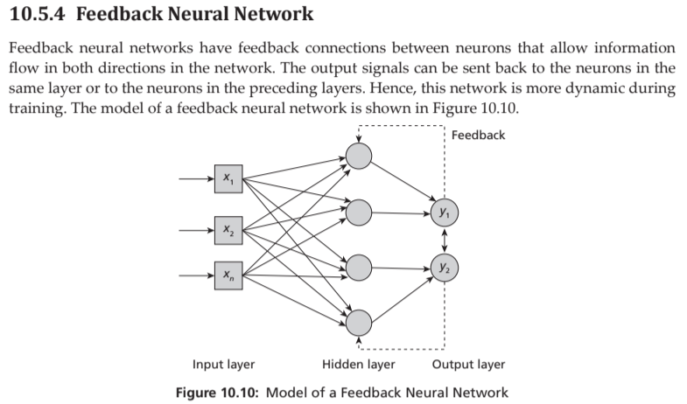

Slide 58
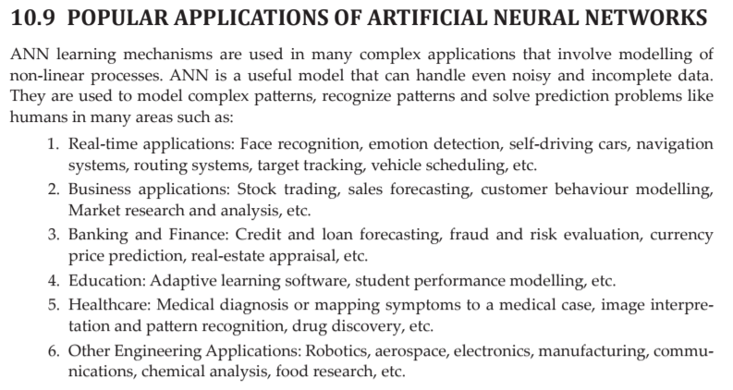

Slide 59
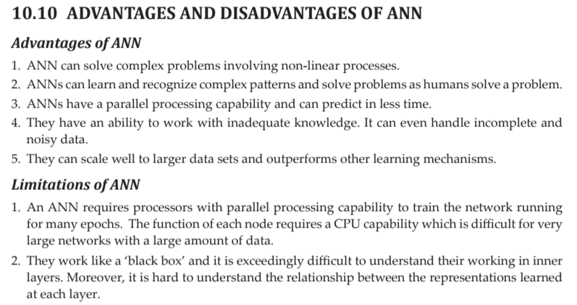

Slide 60
